Slide 1

Futurense Technologies
Project Report
Group M Names:
1.YUVA SANJAY
2.K HARSHAVARDHAN
3.NIKUNJ

Slide 2
INDEX: 1.Intro about Capstone Project[3] 2.Phase1[4-25] 3.Phase 2[26-36] 4.Phase 3[37-52] 5.Phase 4[53-64] 6.Phase 5[65-86] 7.Conclusion[87] 8.References[88-90] 9.Thank You[91]

Slide 3
CAP STONE PROJECT: Year-Long Data Engineering Project: The Journey of a New Data Engineer Welcome to XYZ Company! You have just joined as a Data Engineer, and your first year will be an exciting journey full of learning and challenges. You'll work on a sales dataset to simulate real-world tasks and projects. This journey will help you hone your skills in data cleaning, data ingestion, transformation, warehousing, and visualization. Let's get started!

Slide 4
PROBLEM STATEMENT 1: Phase 1: Initial Data Understanding and Cleaning : How is the distribution of Purchase amounts across different product categories? What is the average purchase amount for each product category? Visualize the same using plots. Which product category has the highest and the lowest purchase amounts?

Slide 5
Description: 1)To discuss the distribution of product amounts across different product categories. 2) The average purchase amount for each product category. 3) Visualize the same using plots. Which product category has the highest and the lowest purchase amounts.

Slide 6
Code: import pandas as pd # Load the CSV file file_path = '/mnt/data/Sales Dataset.csv' sales_df = pd.read_csv("Sales Dataset.csv") # Display the first few rows of the DataFrame sales_df.head() #problem statement 1 import matplotlib.pyplot as plt import seaborn as sns # Boxplot for distribution of purchase amounts plt.figure(figsize=(10, 6)) sns.barplot(x='ProductCategory', y='PurchaseAmount', data=sales_df) plt.title('Purchase Amount Distribution by Product Category') plt.show() # Average purchase amount per product category avg_purchase_per_category = sales_df.groupby('ProductCategory')['PurchaseAmount'].mean() print("Average Purchase Amount per Product Category:\n", avg_purchase_per_category)

Slide 7
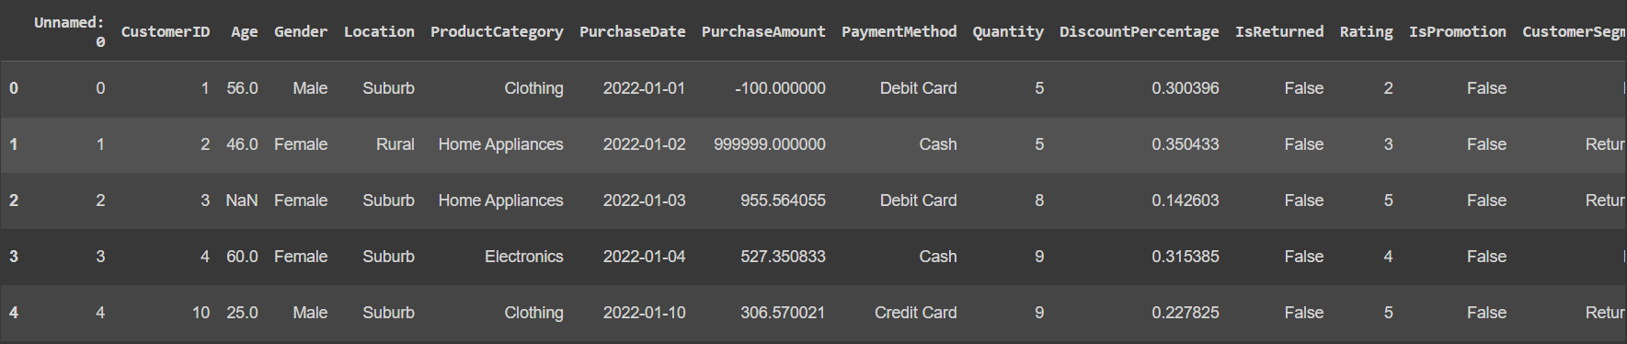
Results And Graph:

Slide 8
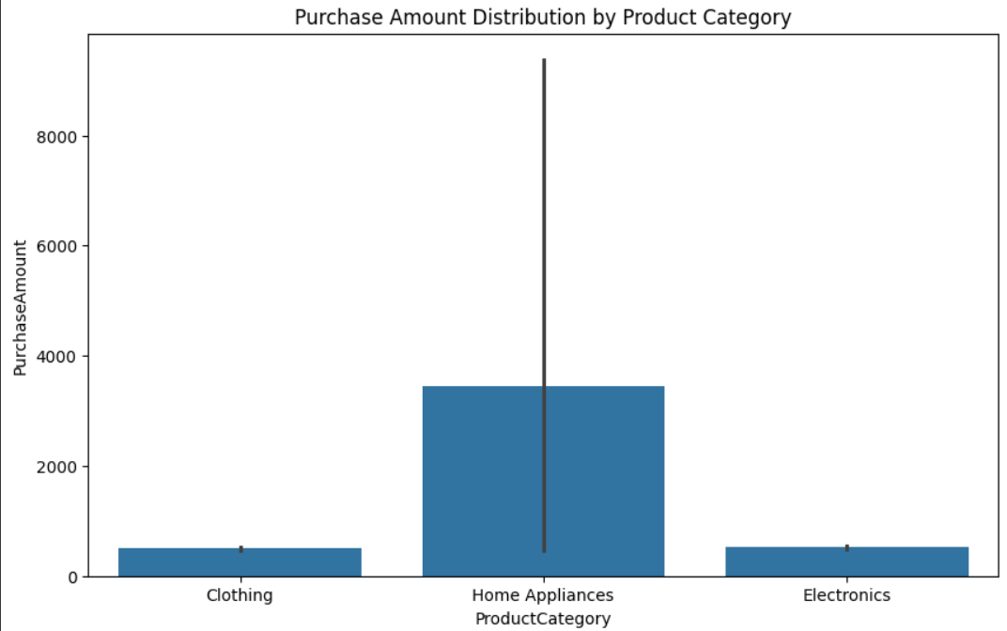
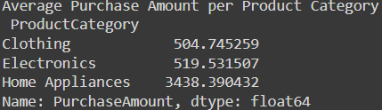
Result And Graph:

Slide 9
Problem statement 2: How do ratings vary based on customer segments? What is the average rating for each customer segment? Which customer segment has the highest and lowest ratings? Create a bar plot to compare the average ratings across customer segments.

Slide 10
Description: 1) To Find Out How ratings vary based on customer segments. 2) average rating for each customer segment 3) Which customer segment has the highest and lowest ratings. 4) Create a bar plot to compare the average ratings across customer segments.

Slide 11
Code: #problem statement 2 # Bar plot for average ratings avg_rating_per_segment = sales_df.groupby('CustomerSegment')['Rating'].mean() plt.figure(figsize=(10, 6)) avg_rating_per_segment.plot(kind='bar') plt.title('Average Rating by Customer Segment') plt.ylabel('Average Rating') plt.show() print("Average Rating per Customer Segment:\n", avg_rating_per_segment)

Slide 12
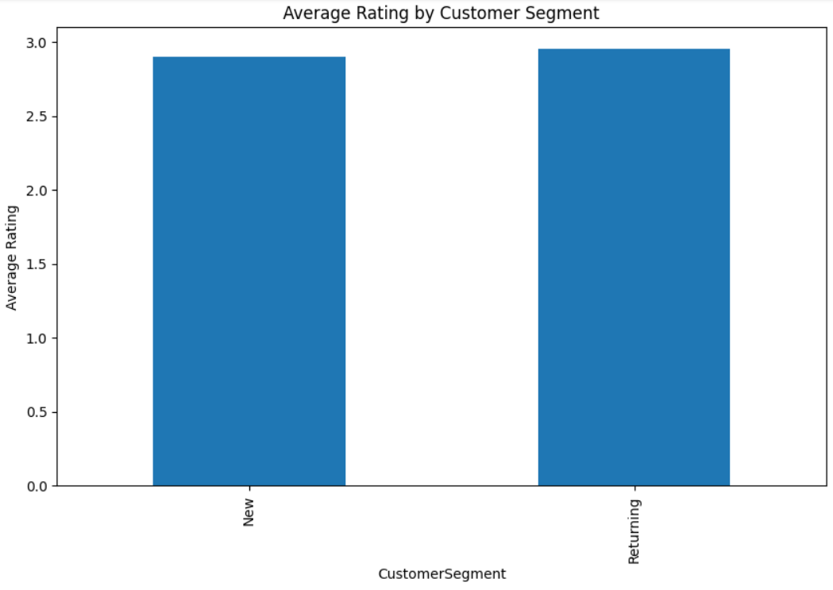
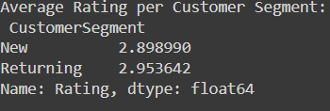
Results And Graph:

Slide 13
Problem Statement 3: Is there any correlation between age and purchase amount? Visualize the same using a heatmap correlation matrix and a scatter plot. Is the correlation between age and purchase amount statistically significant?

Slide 14
Description: 1) To find if there is any correlation between age and purchase amount. 2) Visualize the same using a heatmap correlation matrix and a scatter plot. 3) to find if the correlation between age and purchase amount statistically significant.

Slide 15
Code: #problem statement 3 # Correlation matrix correlation = sales_df[['Age', 'PurchaseAmount']].corr() print("Correlation matrix:\n", correlation) # Heatmap plt.figure(figsize=(10, 6)) sns.heatmap(correlation, annot=True, cmap='coolwarm', vmin=-1, vmax=1) plt.title('Correlation Matrix') plt.show() # Scatter plot plt.figure(figsize=(10, 6)) sns.scatterplot(x='Age', y='PurchaseAmount', data=sales_df) plt.title('Age vs. Purchase Amount') plt.show()

Slide 16
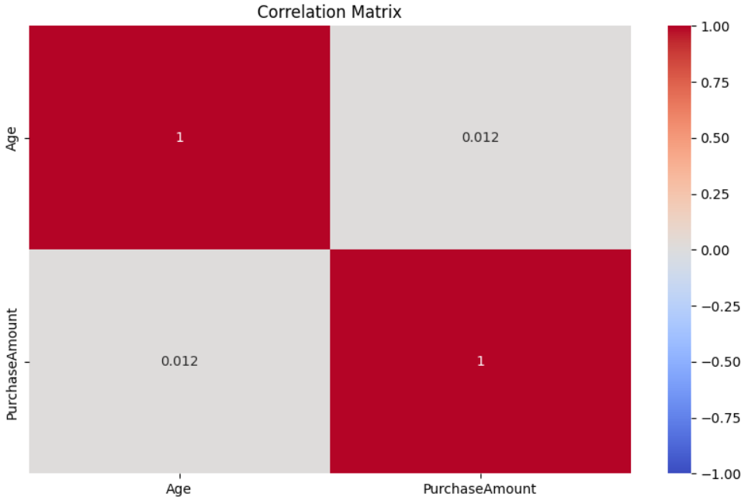
Result And Graph:

Slide 17
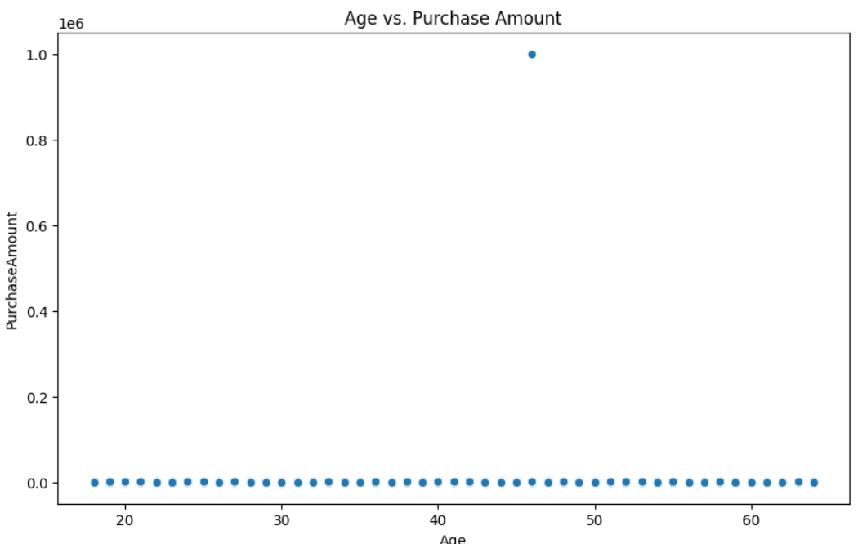
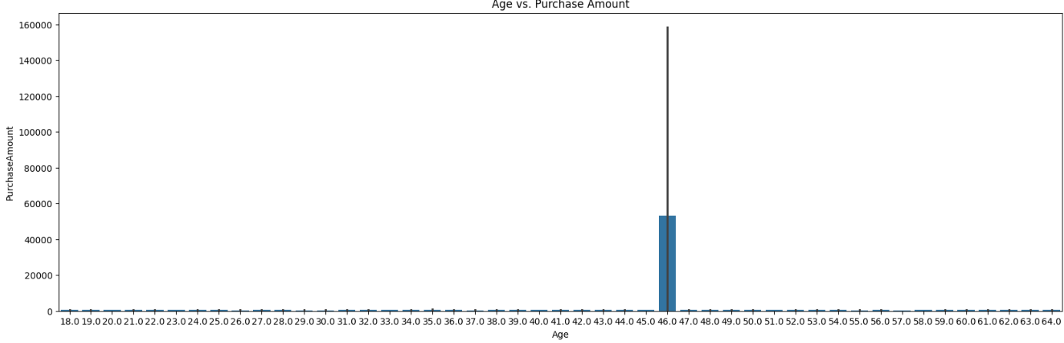
Result And Graph:
Bar graph visualization by changing the graph type to barplot and keeping the fig size as(20,6)

Slide 18
Problem Statement 4: How many unique customers made purchases in each region? How many unique customers are there in total? Which region has the highest and lowest numbers of unique customers? Create any plot visualization to visualize the number of unique customers in each region.

Slide 19
Description: 1)to find How many unique customers made purchases in each region. 2)to find How many unique customers are there in total and Which region has the highest and lowest numbers of unique customers. 3) Create any plot visualization to visualize the number of unique customers in each region.

Slide 20
Code: #problem statement 4 # Number of unique customers per region unique_customers_per_region = sales_df.groupby('Region')['CustomerID'].nunique() plt.figure(figsize=(10, 6)) unique_customers_per_region.plot(kind='bar') plt.title('Unique Customers per Region') plt.ylabel('Number of Unique Customers') plt.show() total_unique_customers = sales_df['CustomerID'].nunique() print("Total number of unique customers:", total_unique_customers)

Slide 21
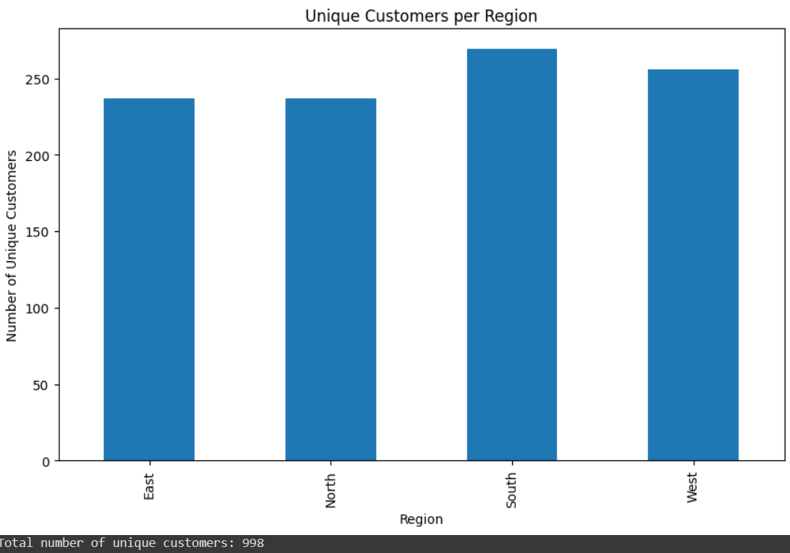
Result And Graph:

Slide 22
Problem Statement 5: Calculate the total purchase amount for each payment method. What are the different payment methods available? What is the total purchase amount for each payment method? Create a pie chart to show the distribution of total purchase amounts across payment methods.

Slide 23
Description: 1) To Calculate the total purchase amount for each payment method and What are the different payment methods available. 2) To find what is the total purchase amount for each payment method. 3) To Create a pie chart to show the distribution of total purchase amounts across payment methods.

Slide 24
Code: #problem statement 5 # Total purchase amount per payment method total_purchase_per_payment_method = sales_df.groupby('PaymentMethod')['PurchaseAmount'].sum() plt.figure(figsize=(10, 6)) total_purchase_per_payment_method.plot(kind='pie', autopct='%.1f%%') plt.title('Total Purchase Amount by Payment Method') plt.ylabel('') plt.show() print("Total Purchase Amount per Payment Method:\n", total_purchase_per_payment_method)

Slide 25
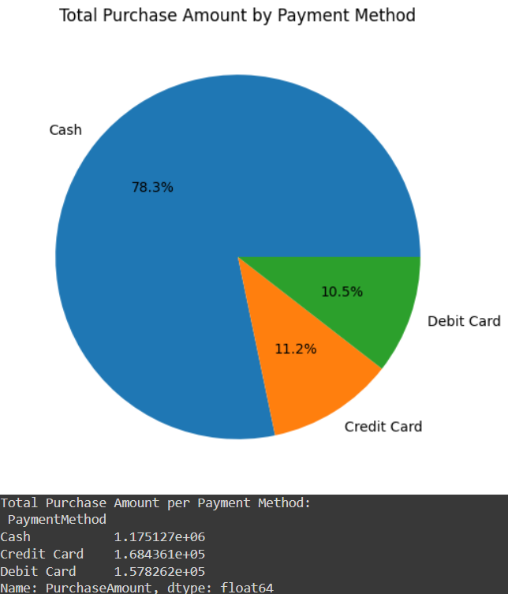
Results And Graphs:

Slide 26
Problem Statement 6: Phase 2: Data Ingestion Strategies: Design a scalable data ingestion pipeline. Document the strategy, including data sources, formats, and frequency.

Slide 27
Description: 1) To design a scalable data ingestion pipeline. Document the strategy, including data sources, formats, and frequency.

Slide 28
Code: # problem statement 6 !pip install pandas sqlalchemy import pandas as pd from sqlalchemy import create_engine # Step 1: Data Extraction def extract_data(file_path): # Load CSV file into a DataFrame df = pd.read_csv('Sales Dataset.csv') return df # Step 2: Data Transformation def transform_data(df): # Example transformations: Handle missing values, convert data types, etc. df = df.dropna() # Drop rows with missing values df['PurchaseDate'] = pd.to_datetime(df['PurchaseDate']) # Convert date column return df # Step 3: Data Loading def load_data(df, db_engine): # Load data into SQL database df.to_sql('salesdata', db_engine, if_exists='replace', index=False) def main(): # File path file_path = '/mnt/data/Sales Dataset.csv' # Database connection string (using SQLite for simplicity) db_engine = create_engine('sqlite:///sales.db’) # Run the pipeline df = extract_data(file_path) df = transform_data(df) load_data(df, db_engine) # Verify the data was loaded result = pd.read_sql('SELECT * FROM salesdata LIMIT 5', db_engine) print(result) if __name__ == '__main__': main()

Slide 29
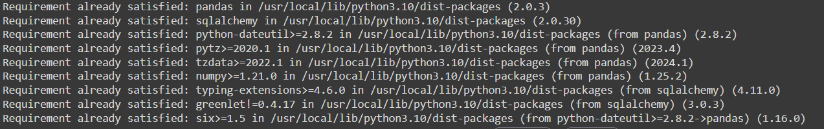
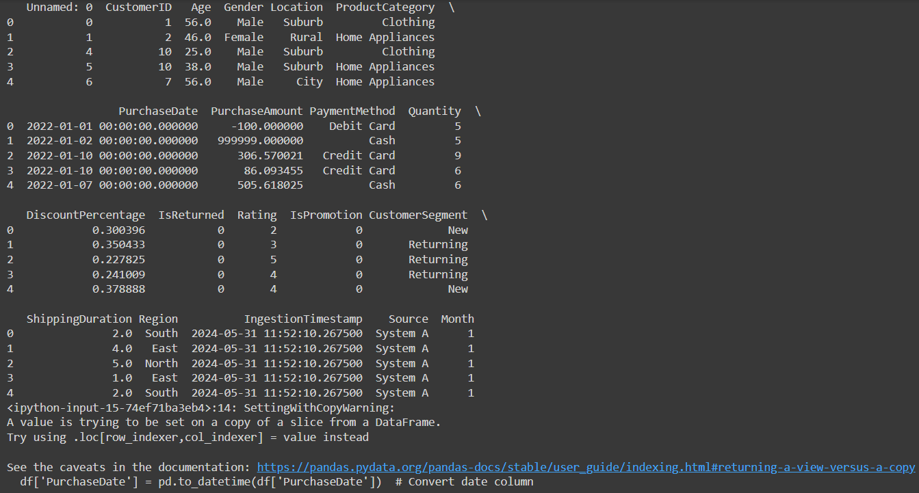
Results And Graphs:

Slide 30
Problem Statement 7: Implement the data ingestion pipeline using Python and Pandas, connecting it to a SQL database for data storage.

Slide 31
Description: To implement the data ingestion pipeline using Python and Pandas, connecting it to a SQL database for data storage

Slide 32
Code: # problem statement 7 from sqlalchemy import create_engine # Example SQL ingestion # Adjust the connection string as needed engine = create_engine('sqlite:///sales.db') # Using SQLite for simplicity sales_df.to_sql('salesdata', engine, if_exists='replace', index=False) # Verify the data was written query_result = pd.read_sql('SELECT * FROM salesdata LIMIT 5', engine) print(query_result)

Slide 33
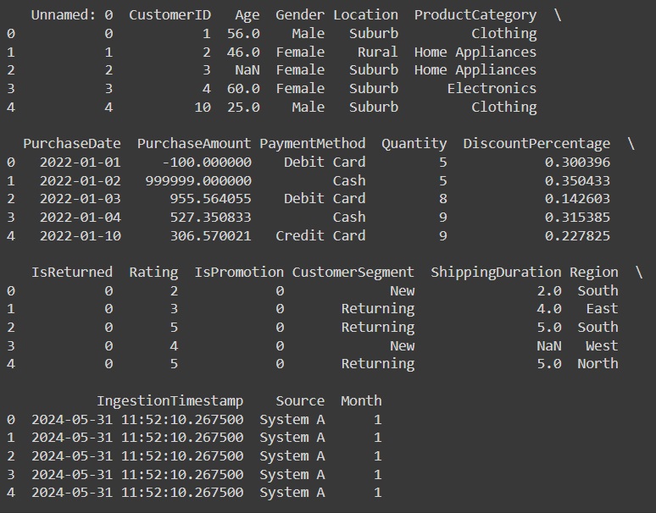
Results And Graphs:

Slide 34
Problem Statement 8: Optimize the ingestion pipeline for performance and storage efficiency. Document the optimization techniques used.

Slide 35
Description: 1)To optimize the ingestion pipeline for performance and storage efficiency. Document the optimization techniques used.

Slide 36
Code: # problem statement 8 # Example of chunking CSV ingestion chunk_size = 10000 chunks = pd.read_csv('Sales Dataset.csv', chunksize=chunk_size) for chunk in chunks: chunk.to_sql('salesdata', engine, if_exists='append', index=False) # Document optimization techniques: # 1. Use chunking for large CSV files to avoid memory overload. # 2. Use multiprocessing to parallelize API calls. # 3. Optimize SQL queries to fetch only necessary columns and rows. # 4. Compress data before storing in the data lake. # 5. Use efficient data formats like Parquet for storage. # 6. Implement indexing in the SQL database for faster queries.

Slide 37
Problem Statement 9: Phase 3: Data Transformation: Calculate the average shipping duration for each location. What are the different locations available in the dataset? Create a bar plot to compare average shipping durations.

Slide 38
Description: 1)To calculate the average shipping duration for each location. 2) To know what are the different locations available in the dataset 3) To create a bar plot to compare average shipping durations.

Slide 39
Code: # problem statement 9 # Average shipping duration per location avg_shipping_duration_per_location = sales_df.groupby('Location')['ShippingDuration'].mean() plt.figure(figsize=(10, 6)) avg_shipping_duration_per_location.plot(kind='bar') plt.title('Average Shipping Duration by Location') plt.ylabel('Average Shipping Duration (days)') plt.show() print("Average Shipping Duration per Location:\n", avg_shipping_duration_per_location)

Slide 40
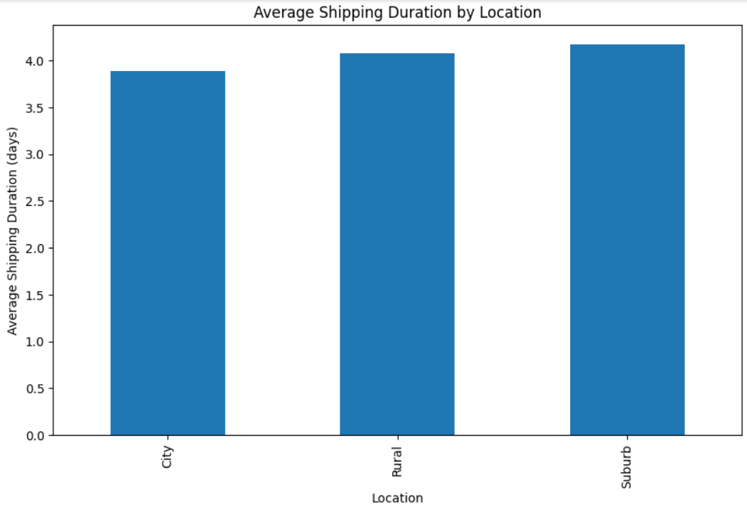
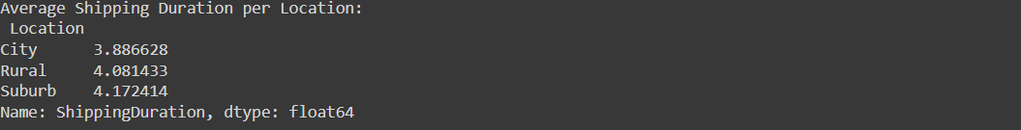
Results And Graphs:

Slide 41
Problem Statement 10: What is the return rate for each product category? Calculate the percentage of purchases returned and visualize the findings.

Slide 42
Description: 1)To find what is the return rate for each product category. 2) To Calculate the percentage of purchases returned and visualize the findings.

Slide 43
Code: # problem statement 10 # Return rate per product category return_rate_per_category = sales_df.groupby('ProductCategory')['IsReturned'].mean() * 100 plt.figure(figsize=(10, 6)) return_rate_per_category.plot(kind='bar') plt.title('Return Rate by Product Category') plt.ylabel('Return Rate (%)') plt.show() print("Return Rate per Product Category:\n", return_rate_per_category)

Slide 44
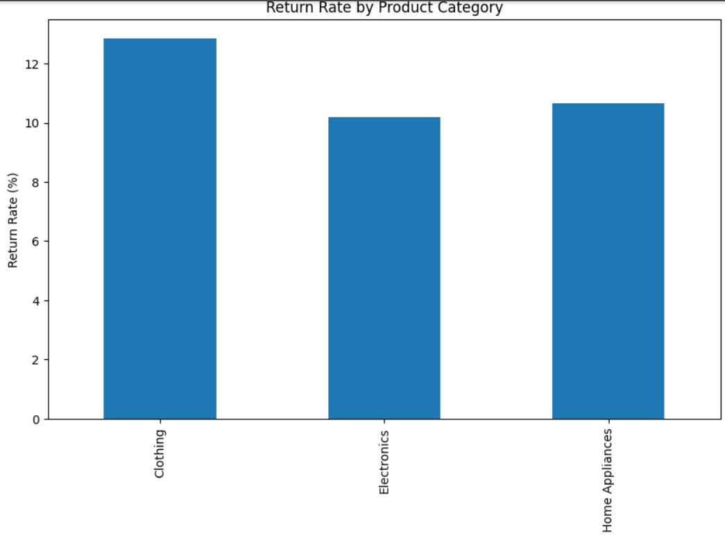
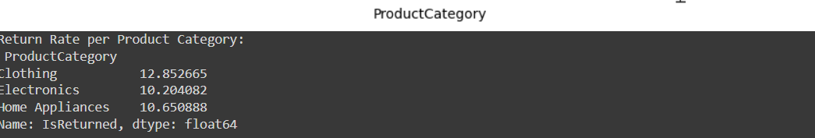
Result And Graph:

Slide 45
Problem Statement 11: Analyze purchase amounts for male and female customers. Perform a statistical test to determine if there's a significant difference between the two groups.

Slide 46
Description: 1) To analyze purchase amounts for male and female customers. 2)To perform a statistical test to determine if there's a significant difference between the two groups.

Slide 47
Code: # problem statement 11 from scipy.stats import ttest_ind # Barplot for purchase amounts by gender plt.figure(figsize=(10, 6)) sns.barplot(x='Gender', y='PurchaseAmount', data=sales_df) plt.title('Purchase Amounts by Gender') plt.show() # Statistical test (t-test) male_purchase = sales_df[sales_df['Gender'] == 'Male']['PurchaseAmount'] female_purchase = sales_df[sales_df['Gender'] == 'Female']['PurchaseAmount'] t_stat, p_value = ttest_ind(male_purchase, female_purchase) print(f"T-statistic: {t_stat}, P-value: {p_value}")

Slide 48
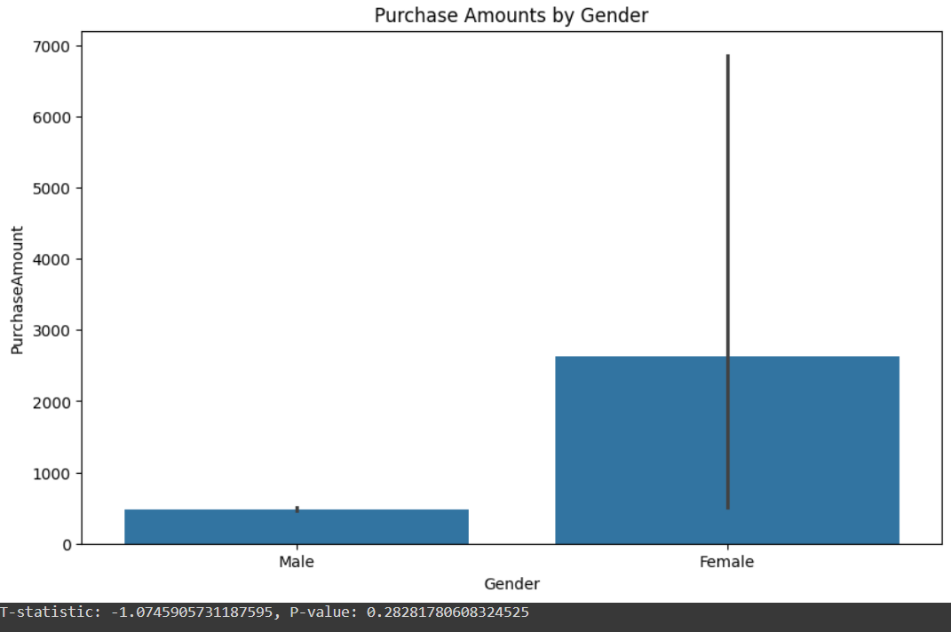
Result And Graph:

Slide 49
Problem Statement 12: Analyze how purchase amounts vary based on the day of the week. Create a plot to visualize the trends and compare weekends versus weekdays.

Slide 50
Description: 1) To analyze how purchase amounts vary based on the day of the week. 2)To create a plot to visualize the trends and compare weekends versus weekdays.

Slide 51
Code: # problem statement 12 # Assuming there's a 'PurchaseDate' column in the dataset sales_df['PurchaseDate'] = pd.to_datetime(sales_df['PurchaseDate']) sales_df['Day_of_Week'] = sales_df['PurchaseDate'].dt.day_name() # Barplot for purchase amounts by day of the week plt.figure(figsize=(10, 6)) sns.barplot(x='Day_of_Week', y='PurchaseAmount', data=sales_df) plt.title('Purchase Amounts by Day of the Week') plt.show() # Compare weekends vs weekdays sales_df['IsWeekend'] = sales_df['Day_of_Week'].isin(['Saturday', 'Sunday']) avg_purchase_weekend = sales_df.groupby('IsWeekend')['PurchaseAmount'].mean() print("Average Purchase Amount (Weekends vs Weekdays):\n", avg_purchase_weekend)

Slide 52
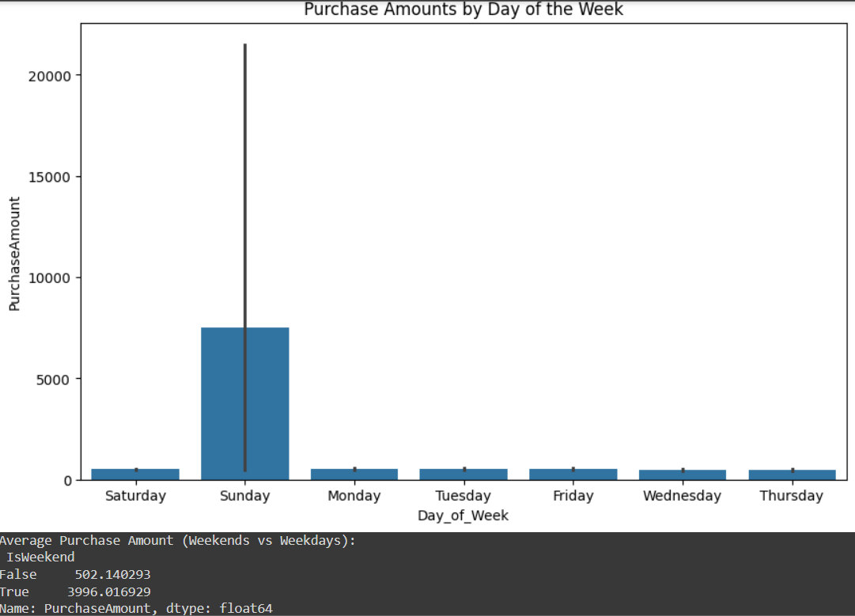
Result And Graph:

Slide 53
Problem Statement 13: Phase 4: Data Warehousing: Design the data warehouse schema. Document the strategy, including tables, relationships, and indexing.

Slide 54
Description: 1)To design the data warehouse schema. Document the strategy, including tables, relationships, and indexing.

Slide 55
Code: -- Create the Customers table: CREATE TABLE Customers ( customer_id INT PRIMARY KEY, name VARCHAR(100), age INT, gender VARCHAR(10), segment VARCHAR(50), region VARCHAR(50)); -- Create the Products table: CREATE TABLE Products ( product_id INT PRIMARY KEY, product_name VARCHAR(100), category VARCHAR(50)); -- Create the Sales table: CREATE TABLE Sales ( sale_id INT PRIMARY KEY, purchase_date DATE, purchase_amount DECIMAL(10, 2), customer_id INT, product_id INT, payment_method VARCHAR(50), rating DECIMAL(3, 2), is_returned BOOLEAN, FOREIGN KEY (customer_id) REFERENCES Customers(customer_id), FOREIGN KEY (product_id) REFERENCES Products(product_id)); -- Create indexes for performance optimization: CREATE INDEX idx_customer_id ON Sales(customer_id); CREATE INDEX idx_product_id ON Sales(product_id); CREATE INDEX idx_purchase_date ON Sales(purchase_date);

Slide 56
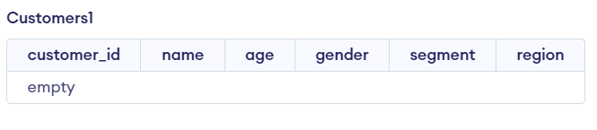
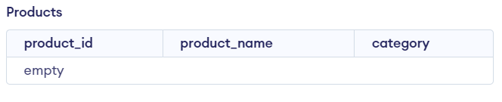
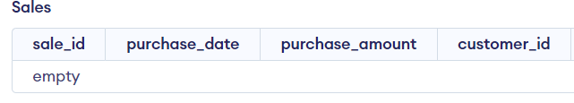
Result And Graph:

Slide 57
Problem Statement 14: Implement the data warehouse using SQL. Optionally, use a cloud-based solution like Amazon RDS for better persistence.

Slide 58
Description: 1)To implement the data warehouse using SQL. Optionally, use a cloud-based solution like Amazon RDS for better persistence.

Slide 59
Code: # problem statement 14 # Implement the data warehouse using SQL (example using SQLite) # Assuming transformed data is in 'transformed_sales_df' transformed_sales_df = sales_df # Placeholder for transformed data engine = create_engine('sqlite:///data_warehouse.db') transformed_sales_df.to_sql('salesfact', engine, if_exists='replace', index=False) # Verify the data was written query_result = pd.read_sql('SELECT * FROM salesfact LIMIT 5', engine) print(query_result)

Slide 60
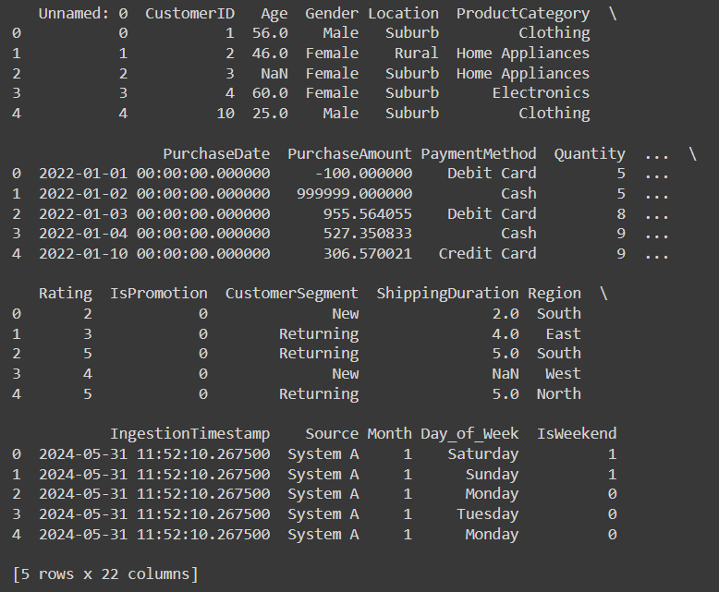
Result And Graph:

Slide 61
Problem Statement 15: Load the transformed data into the data warehouse, ensuring data integrity and consistency.

Slide 62
Description: 1)To load the transformed data into the data warehouse, ensuring data integrity and consistency.

Slide 63
Code: #problem statement 15 import pandas as pd import matplotlib.pyplot as plt #total purchase amount per payment method total_purchase_per_payment_method=sales_df.groupby('PaymentMethod')['PurchaseAmount'].sum() plt.figure(figsize=(8,6)) total_purchase_per_payment_method.plot(kind='pie',autopct='%1.1f%%',startangle=90) plt.title('total purchase amount by payment method') plt.ylabel('') plt.show() print("total purchase amount per payment method:\n",total_purchase_per_payment_method)

Slide 64
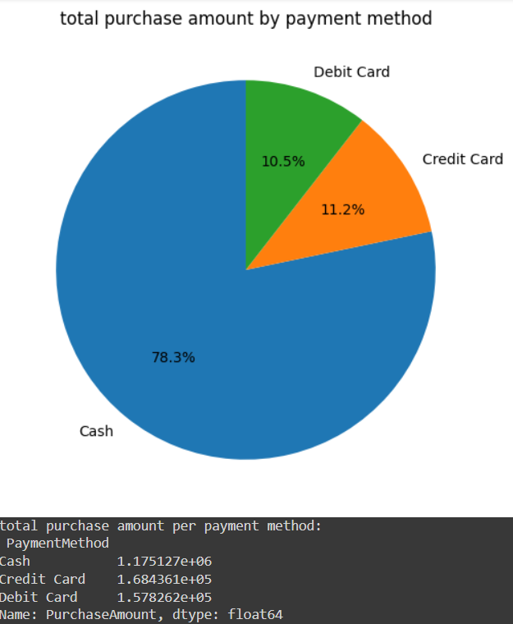
Result And Graph:

Slide 65
Problem Statement 16: Phase 5: Reporting and Visualization: Analyze purchase amounts over time. Create a plot to show the trend of purchase amounts over the months and extract insights.

Slide 66
Description: 1) To analyze purchase amounts over time. 2) To create a plot to show the trend of purchase amounts over the months and extract insights.

Slide 67
Code: #problem statement 16 # Trend of purchase amounts over the months sales_df['Month'] = sales_df['PurchaseDate'].dt.to_period('M') monthly_purchase_amount = sales_df.groupby('Month')['PurchaseAmount'].sum() plt.figure(figsize=(10, 6)) monthly_purchase_amount.plot(kind='line') plt.title('Purchase Amounts Over Time') plt.ylabel('Total Purchase Amount') plt.xlabel('Month') plt.show()

Slide 68
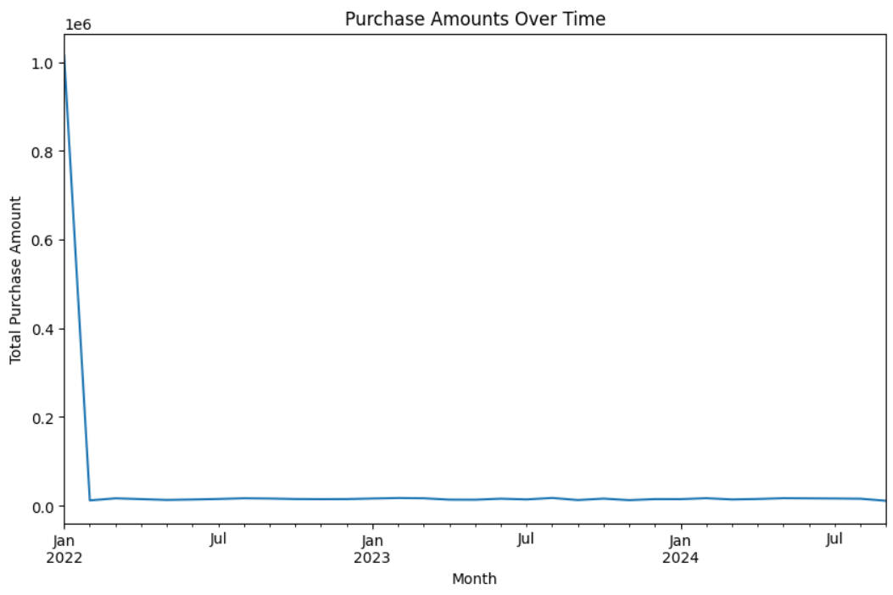
Result And Graph:

Slide 69
Problem Statement 17: Investigate the relationship between purchase amount and discount percentage. Create a scatter plot and calculate the correlation.

Slide 70
Description: 1) To investigate the relationship between purchase amount and discount percentage. Create a scatter plot and calculate the correlation.

Slide 71
Code: #problem statement 17 # Scatter plot and correlation between purchase amount and discount percentage plt.figure(figsize=(10, 6)) sns.scatterplot(x='DiscountPercentage', y='PurchaseAmount', data=sales_df) plt.title('Purchase Amount vs. Discount Percentage') plt.show() correlation = sales_df[['DiscountPercentage', 'PurchaseAmount']].corr() print("Correlation between Discount Percentage and Purchase Amount:\n", correlation)

Slide 72
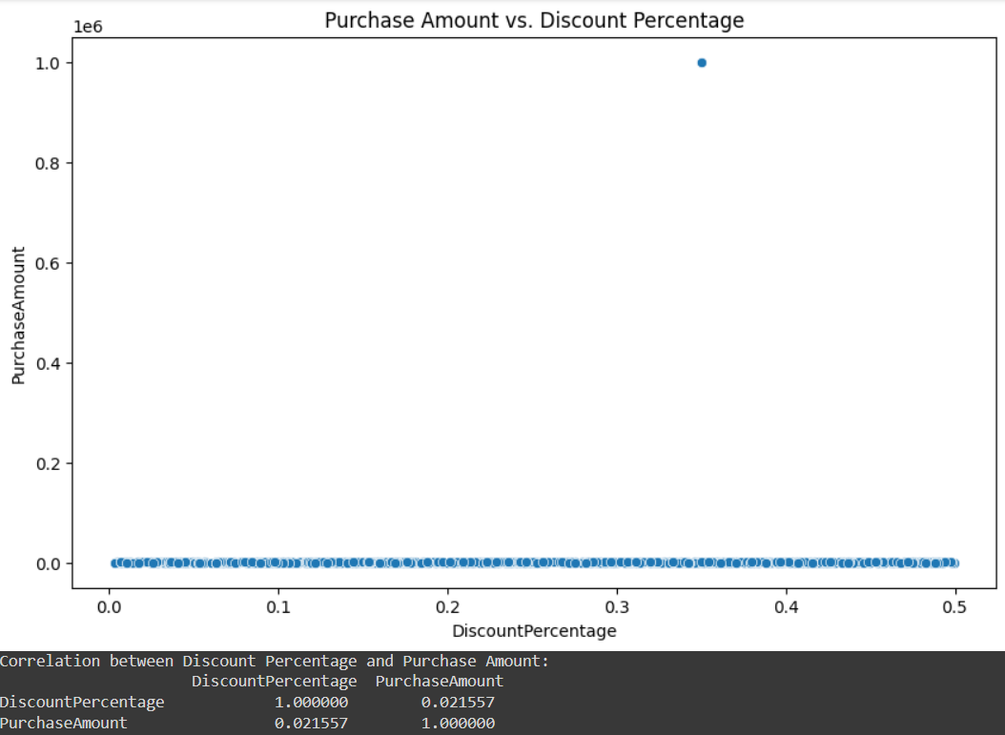
Result And Graph:

Slide 73
Problem Statement 18: Identify instances of multiple purchases on the same day. Create a new column to flag these instances and visualize the findings.

Slide 74
Description: 1)To identify instances of multiple purchases on the same day. Create a new column to flag these instances and visualize the findings.

Slide 75
Code: #p problem statement 18 # Flag instances of multiple purchases on the same day sales_df['PurchaseDate'] = sales_df['PurchaseDate'].dt.date multiple_purchases = sales_df.duplicated(subset=['CustomerID', 'PurchaseDate'], keep=False) sales_df['Multiple_Purchases'] = multiple_purchases plt.figure(figsize=(10, 6)) sns.countplot(x='Multiple_Purchases', data=sales_df) plt.title('Instances of Multiple Purchases on the Same Day') plt.show() print("Flagged instances of multiple purchases:\n", sales_df[sales_df['Multiple_Purchases']].head())

Slide 76
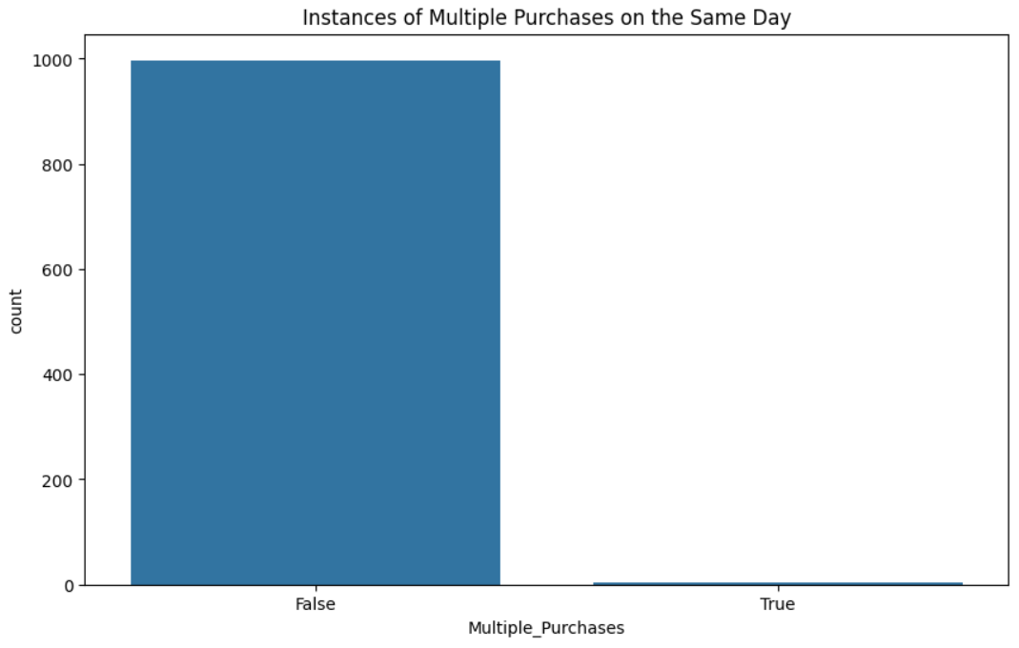
Result And Graph:

Slide 77
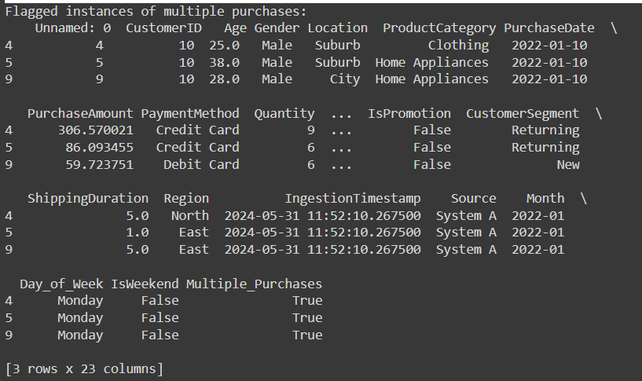
Result And Graph:

Slide 78
Problem Statement 19: Calculate the total purchase amount for each customer segment and product category. Create a pivot table and visualize the results.

Slide 79
Description: 1) To calculate the total purchase amount for each customer segment and product category. 2) To Create a pivot table and visualize the results.

Slide 80
Code: # problem statement 19 # Pivot table for total purchase amount by customer segment and product category pivot_table = sales_df.pivot_table(values='PurchaseAmount', index='CustomerSegment', columns='ProductCategory', aggfunc='sum', fill_value=0) plt.figure(figsize=(12, 8)) sns.heatmap(pivot_table, annot=True, fmt='.0f', cmap='YlGnBu') plt.title('Total Purchase Amount by Customer Segment and Product Category') plt.show() print("Pivot table:\n", pivot_table)

Slide 81
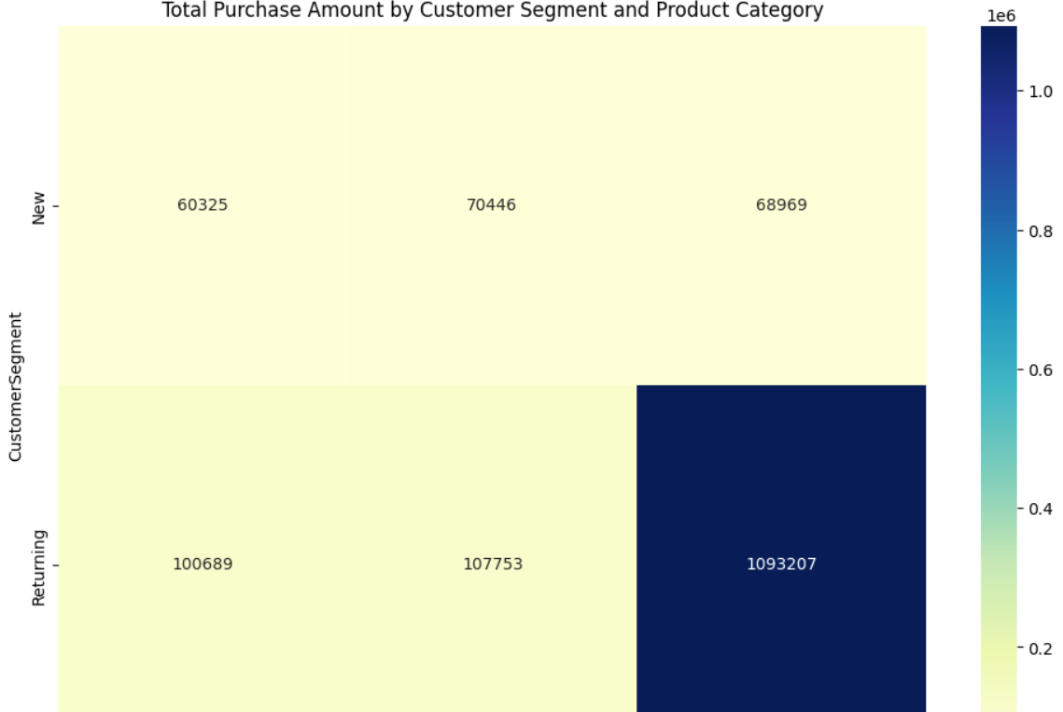
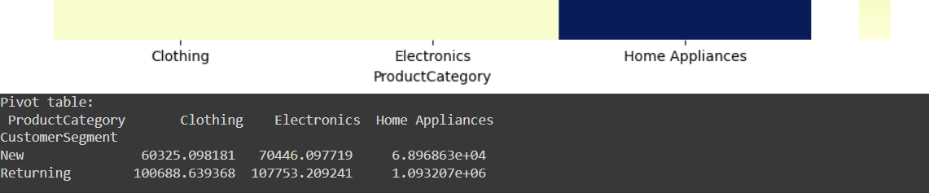
Result And Graph:

Slide 82
Problem Statement 20: Calculate the average purchase amount per customer for each region. Create a new column and visualize the top 5 records.

Slide 83
Description: 1) To calculate the average purchase amount per customer for each region. 2)To create a new column and visualize the top 5 records.

Slide 84
Code: # problem statement 20 # Calculate the average purchase amount per customer for each region avg_purchase_per_customer = sales_df.groupby(['Region', 'CustomerID'])['PurchaseAmount'].mean().reset_index() avg_purchase_per_customer = avg_purchase_per_customer.groupby('Region')['PurchaseAmount'].mean().reset_index() # Sort and display top 5 records top_5_avg_purchase = avg_purchase_per_customer.sort_values(by='PurchaseAmount', ascending=False).head(5) plt.figure(figsize=(10, 6)) sns.barplot(x='Region', y='PurchaseAmount', data=top_5_avg_purchase) plt.title('Top 5 Regions by Average Purchase Amount per Customer') plt.ylabel('Average Purchase Amount') plt.show() print("Top 5 Regions by Average Purchase Amount per Customer:\n", top_5_avg_purchase)

Slide 85
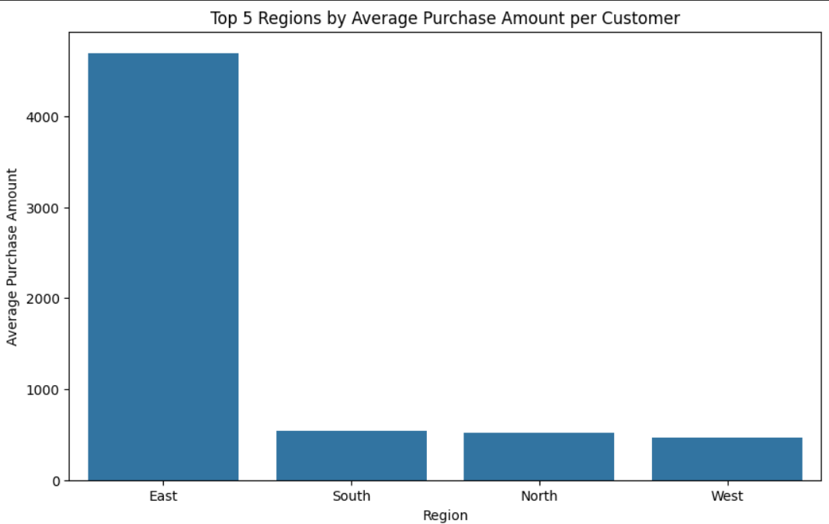
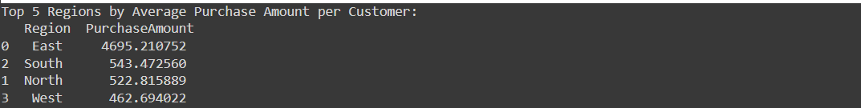
Result And Graph:

Slide 86
Additional Guidance and Resources ### Additional Guidance and Resources 1. **Data Cleaning**: Use Pandas library for data manipulation and cleaning. Refer to the Pandas documentation for comprehensive guides and examples. 2. **Data Ingestion**: Use Python scripts to automate data ingestion processes. Consider using Apache Airflow for orchestrating the data pipelines. 3. **Data Transformation**: Utilize Pandas and SQL for data transformation tasks. You can also explore libraries like Dask for handling large datasets. 4. **Data Warehousing**: Implement data warehousing using cloud solutions like Amazon RDS, Google BigQuery, or Snowflake. Refer to their respective documentations for setup and best practices. 5. **Data Visualization**: Use libraries like Matplotlib, Seaborn, or Plotly for creating visualizations. For more interactive dashboards, consider using tools like Tableau or Power BI. 6. **Collaboration**: Consider using version control systems like Git and platforms like GitHub or GitLab for collaborative work and code management. 7. **Interim Feedback**: Schedule periodic reviews and feedback sessions with your instructor or peers to stay on track and address any challenges early.

Slide 87
Conclusion:
This Cap stone project provides a comprehensive experience in data engineering, from data cleaning and ingestion to transformation, warehousing, and visualization. By completing these tasks, you will develop a deep understanding of the data engineering lifecycle, preparing you for real-world challenges and setting a strong foundation for your career. Enjoy your journey!

Slide 88
References And Resources: ### Phase 1: Initial Data Understanding and Cleaning: 1. **Pandas Documentation**: Comprehensive guide to data manipulation and cleaning using Pandas. - [Pandas Documentation]( https://pandas.pydata.org/docs/ ) 2. **Matplotlib Documentation**: Guide to creating static, interactive, and animated visualizations in Python. - [Matplotlib Documentation]( https://matplotlib.org/stable/contents.html ) 3. **Seaborn Documentation**: Statistical data visualization library based on Matplotlib. - [Seaborn Documentation]( https://seaborn.pydata.org/ ) ### Phase 2: Data Ingestion Strategies: 4. **Apache Airflow Documentation**: Open-source tool to programmatically author, schedule, and monitor workflows. - [ Apache Airflow Documentation]( https://airflow.apache.org/docs/apache-airflow/stable/ ) 5. **SQLAlchemy Documentation**: SQL toolkit and Object-Relational Mapping (ORM) library for Python. - [SQLAlchemy Documentation]( https://docs.sqlalchemy.org/en/14/ ) 6. **Python's Database API (DB-API)**: Standard interface for connecting to relational databases in Python. - [Python DB-API]( https://www.python.org/dev/peps/pep-0249/ ) Company!

Slide 89
### Phase 3: Data Transformation: 7. **Dask Documentation**: Parallel computing with task scheduling library for Python. - [Dask Documentation](https://docs.dask.org/en/stable/) 8. **SQL Documentation**: General reference for SQL language for data manipulation and querying. - [W3Schools SQL Tutorial](https://www.w3schools.com/sql/) ### Phase 4: Data Warehousing: 9. **Amazon RDS Documentation**: Managed relational database service by Amazon Web Services. - [Amazon RDS Documentation](https://docs.aws.amazon.com/rds/index.html) 10. **Google BigQuery Documentation**: Fully managed, serverless data warehouse by Google Cloud. - [Google BigQuery Documentation](https://cloud.google.com/bigquery/docs) 11. **Snowflake Documentation**: Cloud-based data warehousing service. - [Snowflake Documentation](https://docs.snowflake.com/en/) ### Phase 5: Reporting and Visualization: 12. **Plotly Documentation**: Interactive graphing library for Python. - [Plotly Documentation](https://plotly.com/python/) 13. **Tableau Documentation**: Interactive data visualization software. - [Tableau Documentation](https://help.tableau.com/current/pro/desktop/en-us/gettingstarted_overview.htm) 14. **Power BI Documentation**: Business analytics service by Microsoft. - [Power BI Documentation](https://docs.microsoft.com/en-us/power-bi/)

Slide 90
### Collaboration and Version Control: 15. **Git Documentation**: Distributed version control system. - [Git Documentation]( https://git-scm.com/doc ) 16. **GitHub Documentation**: Platform for hosting and collaborating on Git repositories. - [GitHub Documentation]( https://docs.github.com/en/github ) 17. **GitLab Documentation**: DevOps platform for managing Git repositories. - [GitLab Documentation]( https://docs.gitlab.com/ee/ ) ### Additional Guidance and Resources: 18. **Python's Official Documentation**: Comprehensive resource for Python programming. - [Python Documentation]( https://docs.python.org/3/ ) 19. **Scipy Stats Documentation**: Statistical functions for Python. - [Scipy Stats Documentation]( https://docs.scipy.org/doc/scipy/reference/stats.html ) 20. **NumPy Documentation**: Fundamental package for scientific computing with Python. - [NumPy Documentation]( https://numpy.org/doc/ ) 21. **SciKit-Learn Documentation**: Simple and efficient tools for predictive data analysis in Python. - [SciKit-Learn Documentation]( https://scikit-learn.org/stable/ ) These references should provide a solid foundation for your project. Each link directs you to the respective documentation or tutorial to help you understand and implement the various aspects of your data engineering tasks.

Slide 91
THANK YOU

